Slide 1
The Post Correspondence Problem

Slide 2
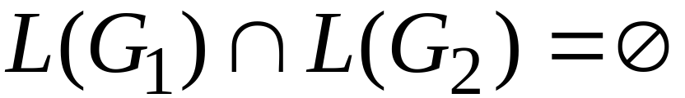


Some undecidable problems for
context-free languages:
Is ?
are context-free grammars
Is context-free grammar ambiguous?

Slide 3
We need a tool to prove that the previous
problems for context-free languages
are undecidable:
The Post Correspondence Problem

Slide 4

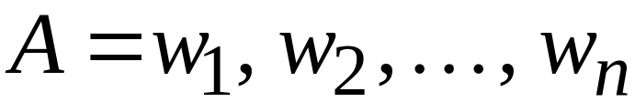
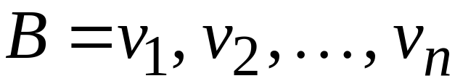
The Post Correspondence Problem
Input:
Two sets of strings

Slide 5
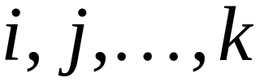
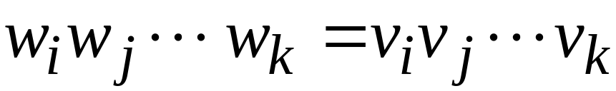
There is a Post Correspondence Solution
if there is a sequence such that:
PC-solution:
Indices may be repeated or omitted

Slide 6

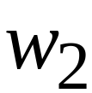
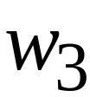










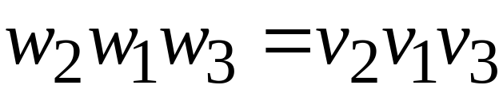

Example:
PC-solution:

Slide 7






Example:
There is no solution
Because total length of strings from
is smaller than total length of strings from

Slide 8
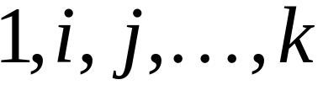
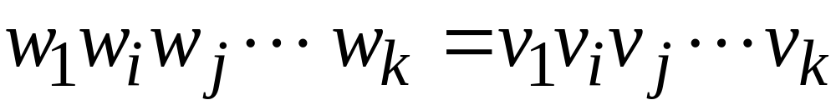
The Modified Post Correspondence Problem
Inputs:
MPC-solution:

Slide 9

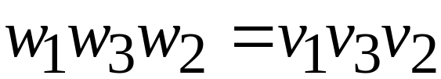
Example:
MPC-solution:

Slide 10
We will show:
1. The MPC problem is undecidable
(by reducing the membership to MPC)
2. The PC problem is undecidable
(by reducing MPC to PC)

Slide 11
Theorem: The MPC problem is undecidable
Proof: We will reduce the membership
problem to the MPC problem

Slide 12



Membership problem
Input: Turing machine
string
Question:
Undecidable

Slide 13


Membership problem
Input: unrestricted grammar
string
Question:
Undecidable

Slide 14


Suppose we have a decider for
the MPC problem
String Sequences
MPC solution?
YES
MPC problem
decider
NO

Slide 15



We will build a decider for
the membership problem
YES
Membership
problem
decider
NO

Slide 16
The reduction of the membership problem
to the MPC problem:
Membership problem decider
yes
yes
MPC problem
decider
no
no

Slide 17
We need to convert the input instance of
one problem to the other
Membership problem decider
yes
yes
MPC problem
decider
Reduction?
no
no

Slide 18




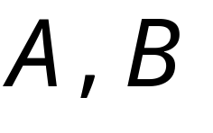
Reduction:
Convert grammar and string
to sets of strings and
Such that:
There is an MPC
solution for
generates

Slide 19






Grammar
: start variable
: special symbol
For every symbol
For every variable

Slide 20






Grammar
string
: special symbol
For every production

Slide 21
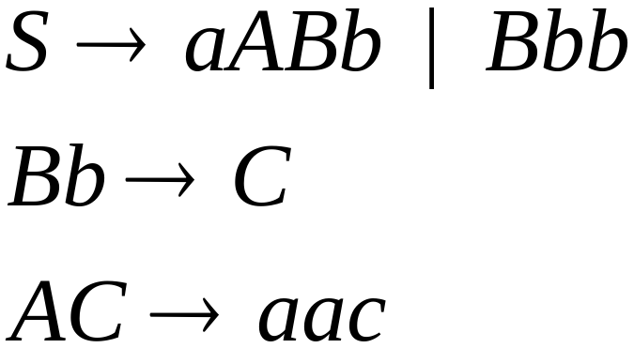

Example:
Grammar :
String

Slide 22

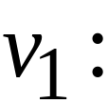
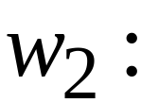
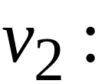
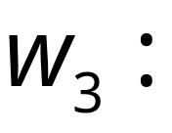
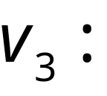




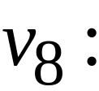

Slide 23


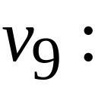







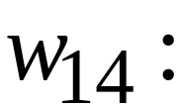
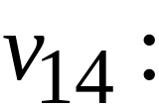

Slide 24

Grammar :

Slide 25



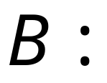
Derivation:

Slide 26


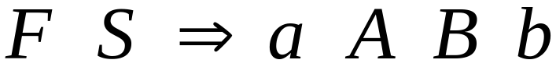
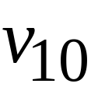
Derivation:

Slide 27

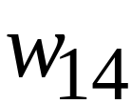

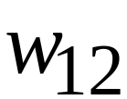
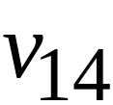

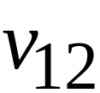
Derivation:

Slide 28
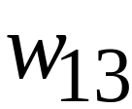
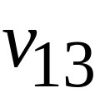
Derivation:

Slide 29


Derivation:

Slide 30


has an MPC-solution
if and only if

Slide 31

Membership problem decider
yes
yes
Construct
MPC problem
decider
no
no

Slide 32
Since the membership problem is undecidable,
The MPC problem is undecidable
END OF PROOF

Slide 33
Theorem: The PC problem is undecidable
Proof: We will reduce the MPC problem
to the PC problem

Slide 34


Suppose we have a decider for
the PC problem
String Sequences
PC solution?
YES
PC problem
decider
NO

Slide 35
We will build a decider for
the MPC problem
String Sequences
MPC solution?
YES
MPC problem
decider
NO

Slide 36


The reduction of the MPC problem
to the PC problem:
MPC problem decider
yes
yes
PC problem
decider
no
no

Slide 37
We need to convert the input instance of
one problem to the other
MPC problem decider
yes
yes
PC problem
decider
Reduction?
no
no

Slide 38

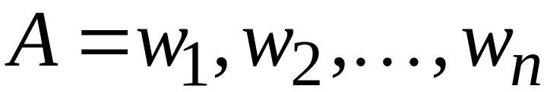
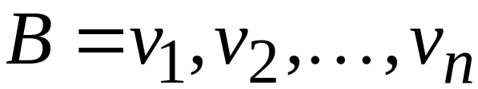
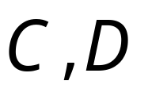
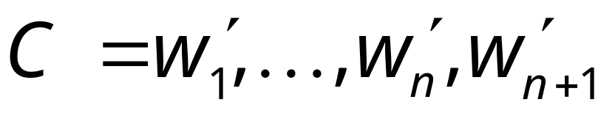
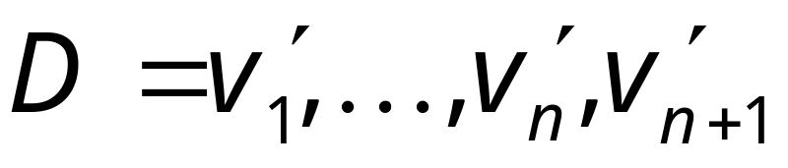
: input to the MPC problem
Translated to
: input to the PC problem

Slide 39
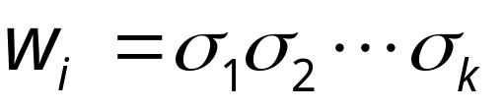


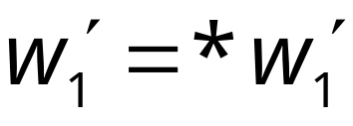
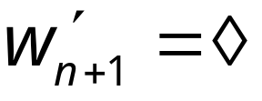
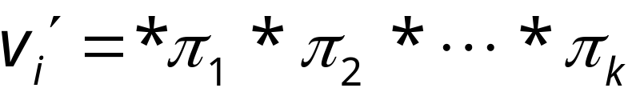
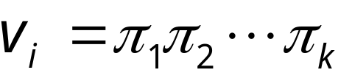
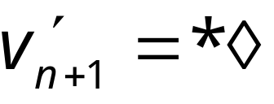
For each
replace
For each

Slide 40
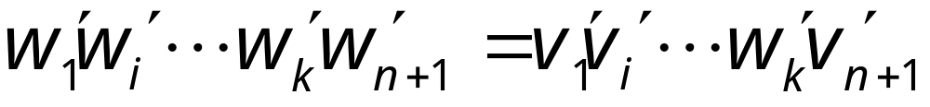
PC-solution
Has to start with
These strings

Slide 41

PC-solution
MPC-solution

Slide 42

has a PC solution
if and only if
has an MPC solution

Slide 43

MPC problem decider
yes
yes
Construct
PC problem
decider
no
no

Slide 44
Since the MPC problem is undecidable,
The PC problem is undecidable
END OF PROOF

Slide 45
Some undecidable problems for
context-free languages:
Is ?
are context-free grammars
Is context-free grammar
ambiguous?
We reduce the PC problem to these problems

Slide 46
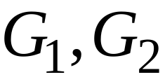
Theorem:
Let be context-free
grammars. It is undecidable
to determine if
(intersection problem)
Proof:
Reduce the PC problem to this
problem

Slide 47


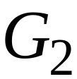
Suppose we have a decider for the
intersection problem
Context-free
grammars
Empty-
interection
problem
decider
YES
NO

Slide 48
We will build a decider for
the PC problem
String Sequences
PC solution?
YES
PC problem
decider
NO

Slide 49


The reduction of the PC problem
to the empty-intersection problem:
PC problem decider
no
yes
Intersection
problem
decider
yes
no

Slide 50
We need to convert the input instance of
one problem to the other
PC problem decider
no
yes
Intersection
problem
decider
Reduction?
yes
no

Slide 51
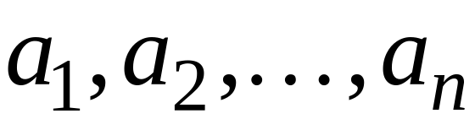


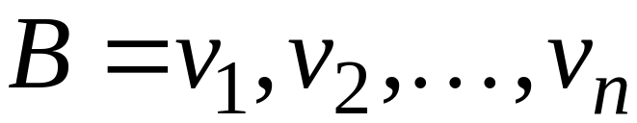
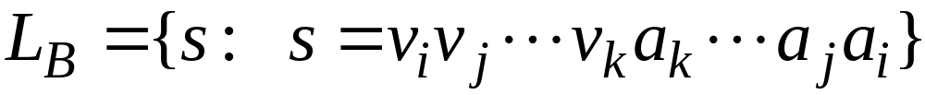

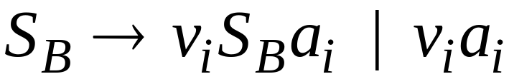
Introduce new unique symbols:
Context-free grammar :
Context-free grammar :

Slide 52

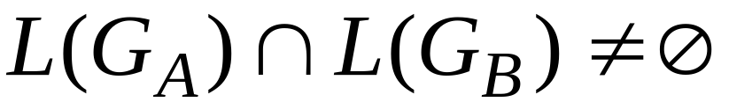
has a PC solution
if and only if

Slide 53




Because are unique
There is a PC solution:

Slide 54
PC problem decider
no
yes
Construct
Context-Free
Grammars
Intersection
problem
decider
yes
no

Slide 55
Since PC is undecidable,
the Intersection problem is undecidable
END OF PROOF

Slide 56
Theorem:
For a context-free grammar ,
it is undecidable to determine
if G is ambiguous
Proof:
Reduce the PC problem
to this problem

Slide 57

PC problem decider
no
yes
Construct
Context-Free
Grammar
Ambiguous
problem
decider
yes
no

Slide 58





start variable of
start variable of
start variable of

Slide 59
has a PC solution
if and only if
if and only if
is ambiguous

